Slide 1
ASP NET Web API REST Introduction

Slide 2
Agenda
ASP.NET Core Essentials
Overview
What is it?
Why do you care?
Essentials
Simple REST GET Example
Essential REST Verbs
GET, POST, PUT, PATCH,DELETE

Slide 3

Overview

Slide 4
ASP.NET Web API Overview
Overview
Framework for building HTTP-based services
RESTful APIs for consumption by
Web, Mobile, Desktop and others
Runs on ASP.NET Core
Is cross-platform
Windows
Linux
macOS

Slide 5
ASP.NET Web API Overview
What is it?
Lightweight server framework
Exposing functionality over HTTP
Uses controllers & minimal APIs
To handle requests and return responses
Supports a middleware pipeline
Enables extension of request & response processing
Centralizes cross-cutting concerns
Handles authentication and authorization
Establishes and enriches user context
For downstream components

Slide 6
ASP.NET Web API Overview
Why do you care?
Enables clean separation
Between frontend & backend
Scales from small internal services
To large, cloud-hosted APIs
Built-in support for
Azure App Service, Containers, and Functions
Industry-standard approach for building
Interoperable services

Slide 7
ASP.NET Core - Essentials
ASP.NET Core:
Easy creation of REST services
Excellent support for HTTP Responses
Automatic documentation
Asynchronous execution
Support for key media types
JSON
XML
Plain Text
BSON

Slide 8
ASP.NET Core Essentials
CORS Cross Origin Request Sharing support
Support for browsers to allow some CORS
While rejecting others
See: Enable Cross-Origin Requests (CORS) in ASP.NET Core
Middleware
Centralized handling of requests & responses
See: ASP.NET Core Middleware

Slide 9
ASP.NET Core Essentials
Supports several authentication schemes
ASP.NET Identity See: Configure ASP.NET Core Identity
Individual Accounts (Custom)
Creating projects managed in a local database
External Authentication Services
Facebook, Google, Microsoft, Apple (preview)
GitHub
OpenId Connect generic providers
X (formerly Twitter)
Microsoft Entra Id

Slide 10
ASP.NET Core Essentials
Azure Active Directory B2C
Basic Authentication
Forms Authentication
Integrated Windows Authentication
OAUTH 2.0
OpenID Connect
…

Slide 11
ASP.NET Core Essentials
Support for OpenAPI 3
Open API JSON document
Useful for
Generating client-side SDK
Integration into Azure services such as API Management
Interactive UI
Allows for a “Developer” playground
Try out your APIs
Customizable
Style it to your liking

Slide 12
Overview

Slide 13


Let's Code!

Slide 14
Weather Azure App Service
Several templates available for .NET 10
ASP.NET Core Empty
ASP.NET Core Web App
ASP.NET Core Web API
ASP.NET Core Web API (native AOT)
ASP.NET Core Web App (Model-View-Controller)
ASP.NET Core gRPC Service
ASP.NET Core Web App (Razor Pages)
…

Slide 15

Visual Studio 2026

Slide 16
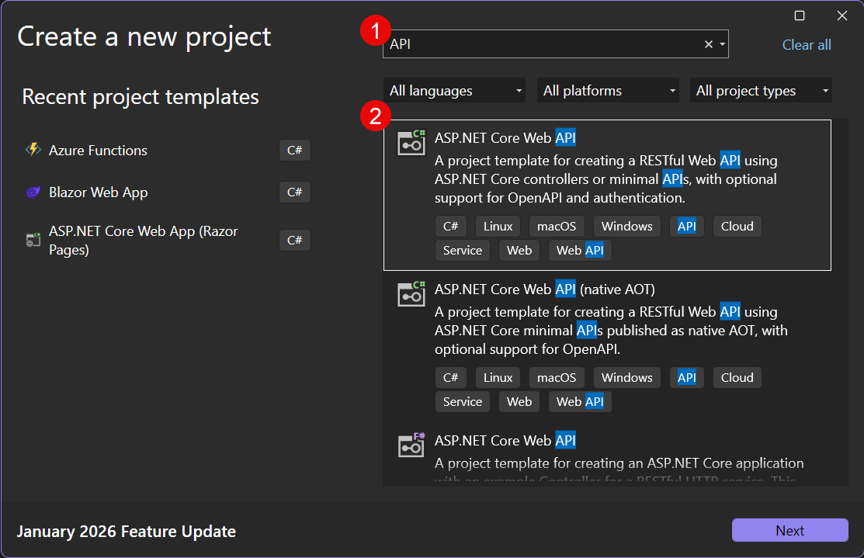
Weather Azure App Service
Starting with the default template …
Create a new project

Slide 17
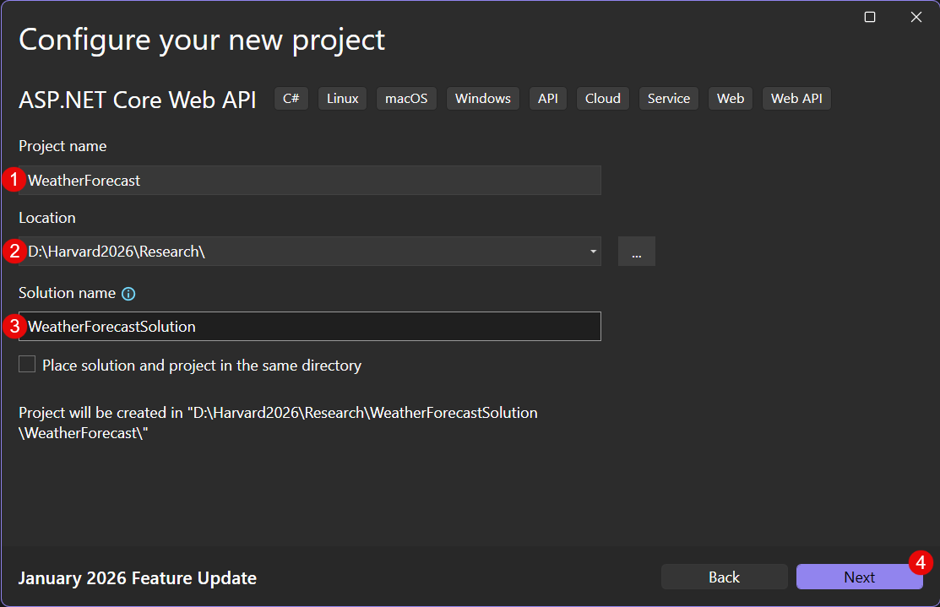
Weather Azure App Service
Additional Information
Name your project and solution

Slide 18
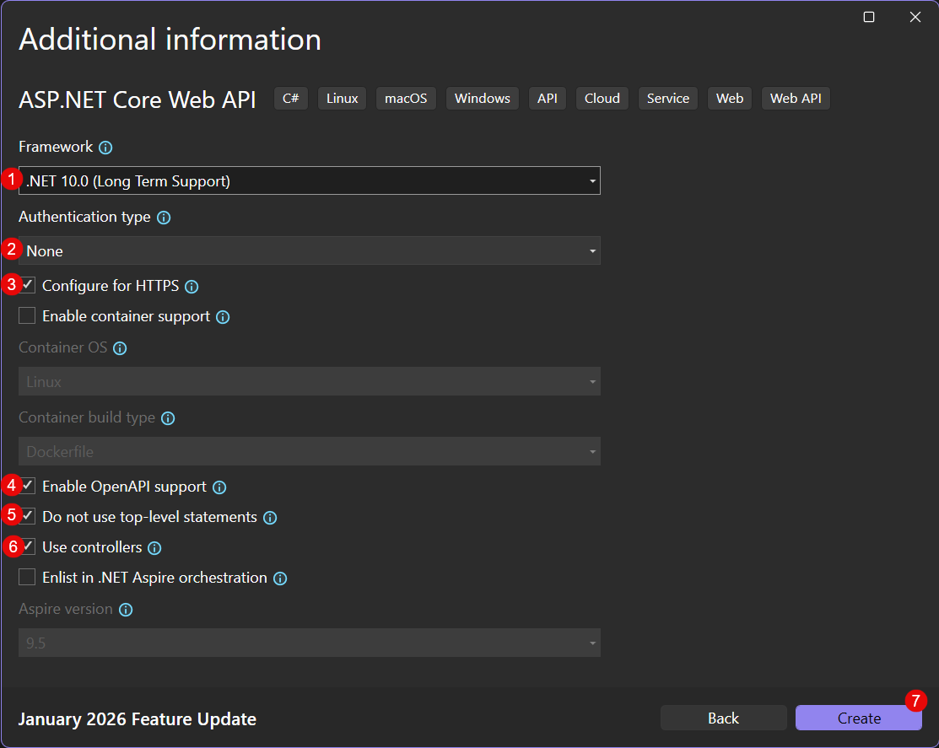
Weather Azure App Service
Additional Information

Slide 19

VS Code

Slide 20
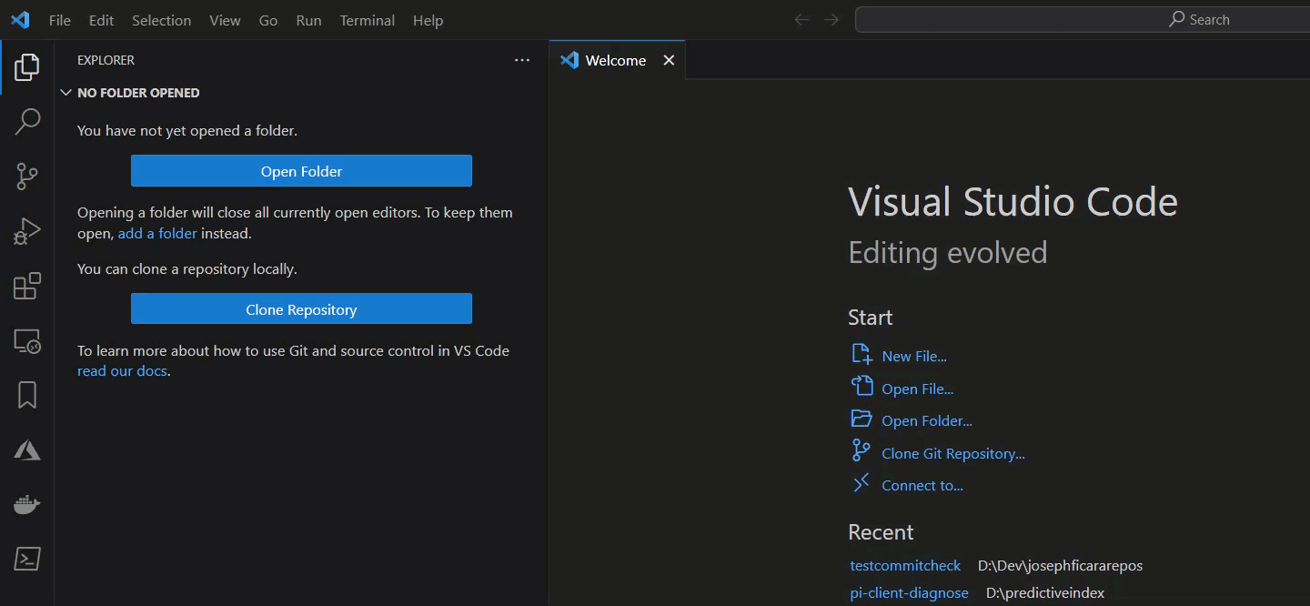
Weather Azure App Service
VS Code
Install the VS Code Dev Kit Extension

Slide 21
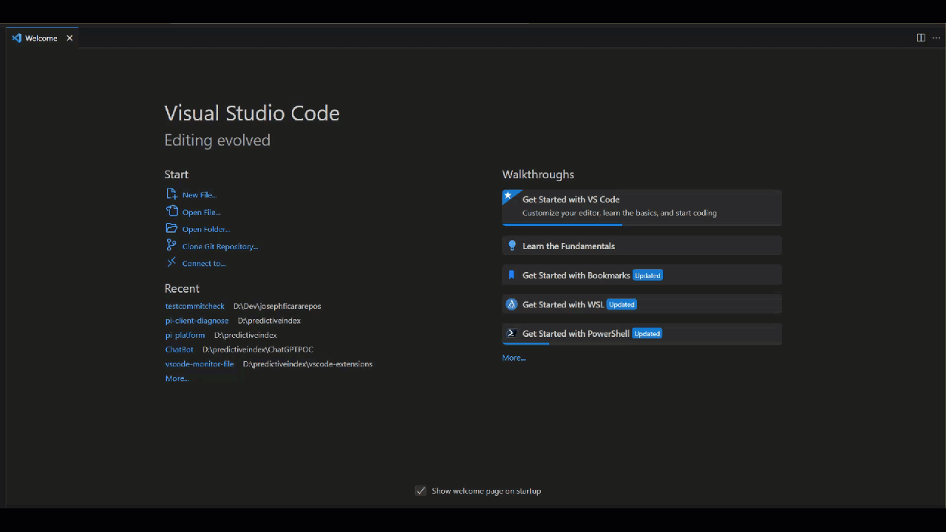
Weather Azure App Service VSCode
Follow steps Getting Started with C# Dev Kit

Slide 22
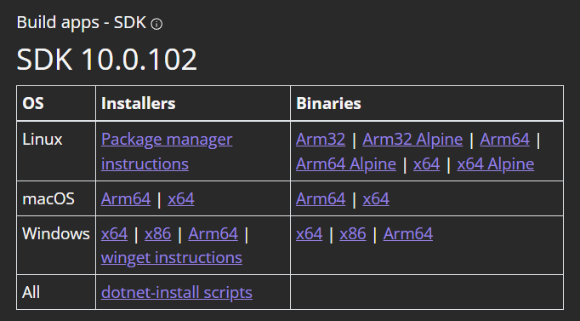
Weather Azure App Service VSCode
.NET 10 SDK Download & Install
Download .NET 10.0

Slide 23
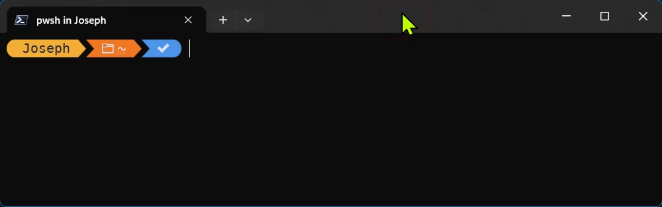
Weather Azure App Service VSCode
Verify .NET 10 SDK is Installed
10.0.102 or greater is fine

Slide 24
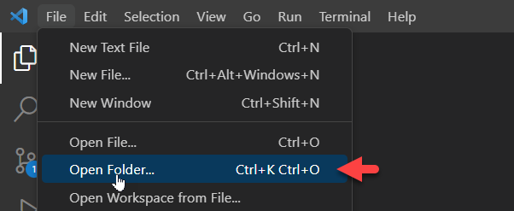
Weather Azure App Service VSCode
Select an empty folder in VS Code
Use the command line to create your project
dotnet new webapi --framework net10.0 --use-controllers --use-program-main -n <project name>

Slide 25
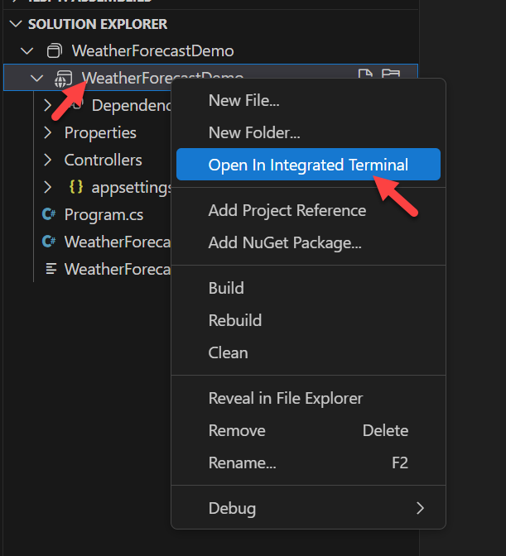
Weather Azure App Service VSCode
Generate your secrets.json file
Open a terminal in your project directory

Slide 26
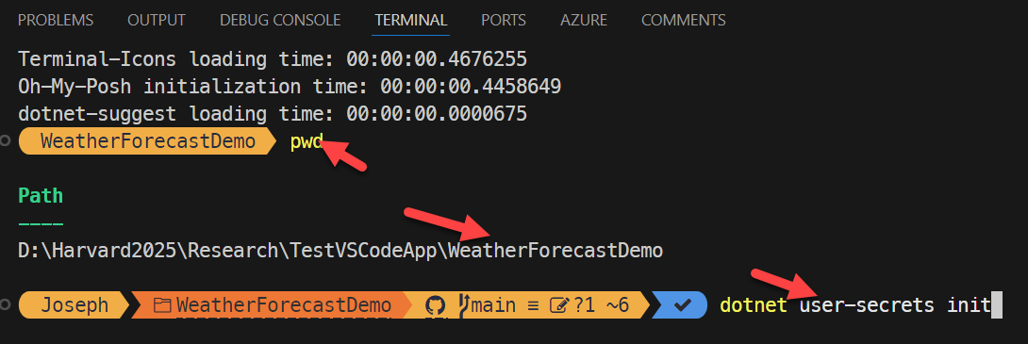
Weather Azure App Service VSCode
Generate your secrets.json file …
Verify that you are in your project directory
Run dotnet user-secrets init

Slide 27
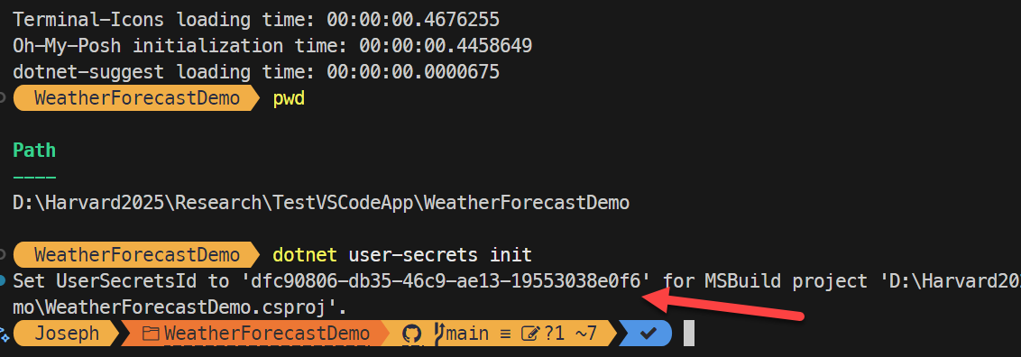
Weather Azure App Service VSCode
Generate your secrets.json file …
Result should look like this

Slide 28
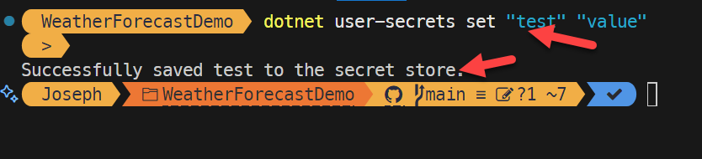
Weather Azure App Service VSCode
Generate your secrets.json file …
Set a test value
To generate the secrets.json file

Slide 29
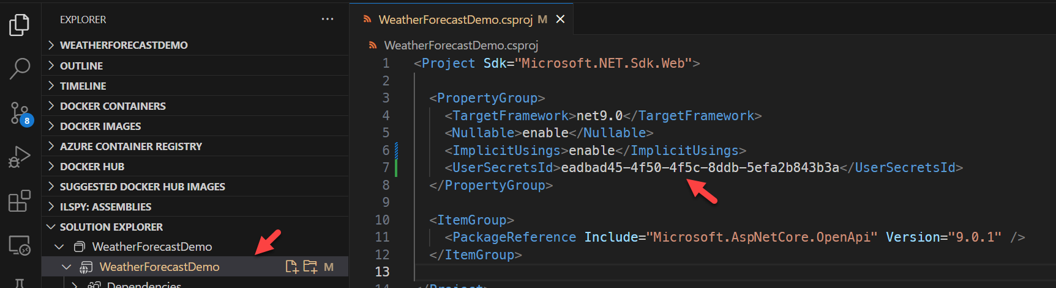
Weather Azure App Service VSCode
Generate your secrets.json file …
Double click on your project file
To verify the secret folder name

Slide 30
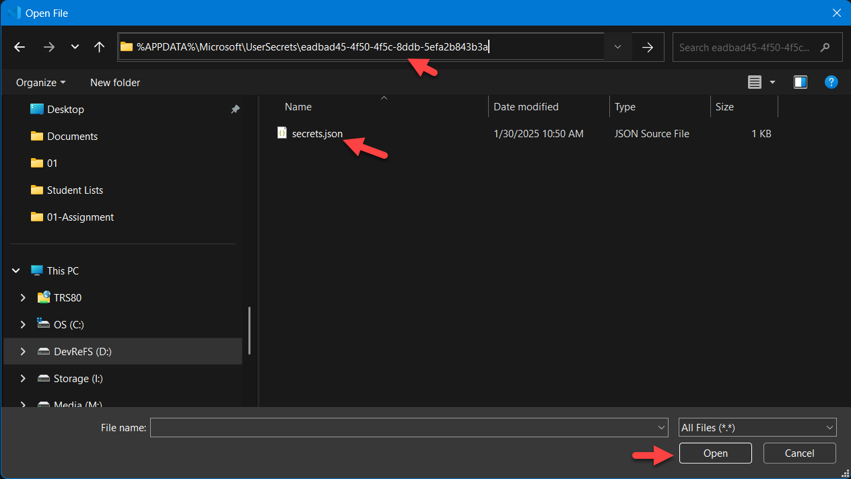
Weather Azure App Service VSCode
Edit the secrets.json file in vs code
The windows path will be
%APPDATA%\Microsoft\UserSecrets\eadbad45-4f50-4f5c-8ddb-5efa2b843b3a

Slide 31
Weather Azure App Service VSCode
secrets.json folder paths for
Windows
%APPDATA%\Microsoft\UserSecrets\{UserSecretsId}\secrets.json
macOS/Linux
~/.microsoft/usersecrets/{UserSecretsId}/secrets.json

Slide 32
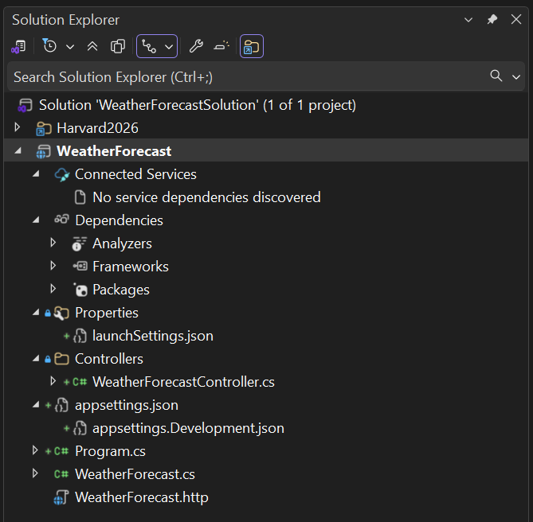


ASP.NET Core Web API Structure

Slide 33
Weather Azure App Service
ASP.NET Core Web API template
Project structure
Properties
Publisher profiles will reside here
Used to define how to publish your Web API to Azure
Don’t share them or put them in source control
Service Dependencies
Azure Resource Templates that define the resources used
launchSettings.json
Used by Visual Studio to direct how to run the app locally

Slide 34
Weather Azure App Service ASP.NET Core Web API template …
Project structure …
Controllers
Classes that handle HTTP requests go here
Http Verbs automatically routed to methods
HTTP Verb GET routes to a method called Get()
Clearer to use the C# Attribute [HttpGet]
Controllers/WeatherForcastController.cs
Sample code that generates random weather results

Slide 35
Weather Azure App Service ASP.NET Core Web API template …
Project structure …
appsettings.json
Contain configuration in JSON format
appsettings.development.json
Settings used for local development
Program.cs
Main entry point for the Web API app
WeatherForcast.cs
Class that defines result of GET action
WeatherForecast.http
A .http file used for testing your Web APIs

Slide 36

Weather Azure App Service ASP.NET Core Web API template …
Project structure …
http-client.env.json
Not added by default
Used to define the environments for the .http file
readme.md
Not added by default
Used to describe / provide notes about the application
Let's create both using GitHub Copilot

Slide 37
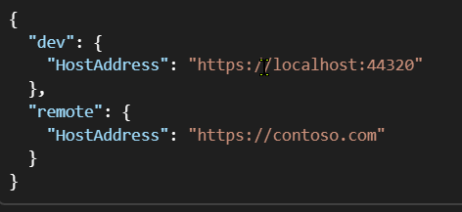
Weather Azure App Service AI Coding
http-client.env.json file
Defines environments used for testing
Specifies an environment name and URL
dev & remote are the environment names
HostAddress is the variable the URL is assigned to
Referenced in the http file like this

Slide 38
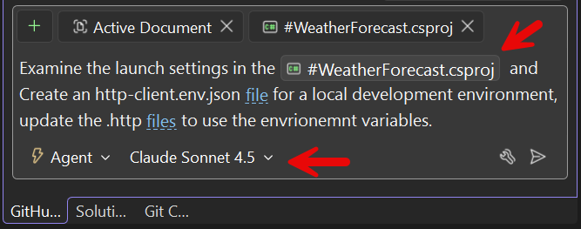
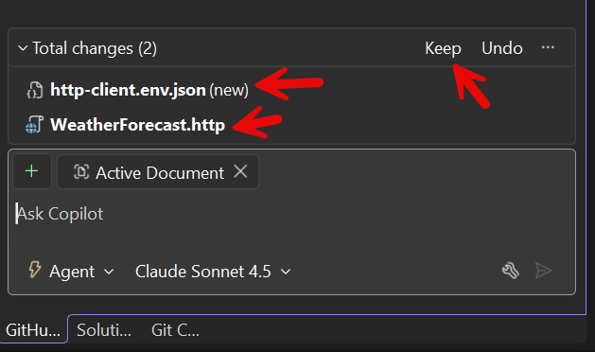
Weather Azure App Service AI Coding
Many more capabilities
See Environment Files
GitHub Copilot can create .env file
update .http file

Slide 39
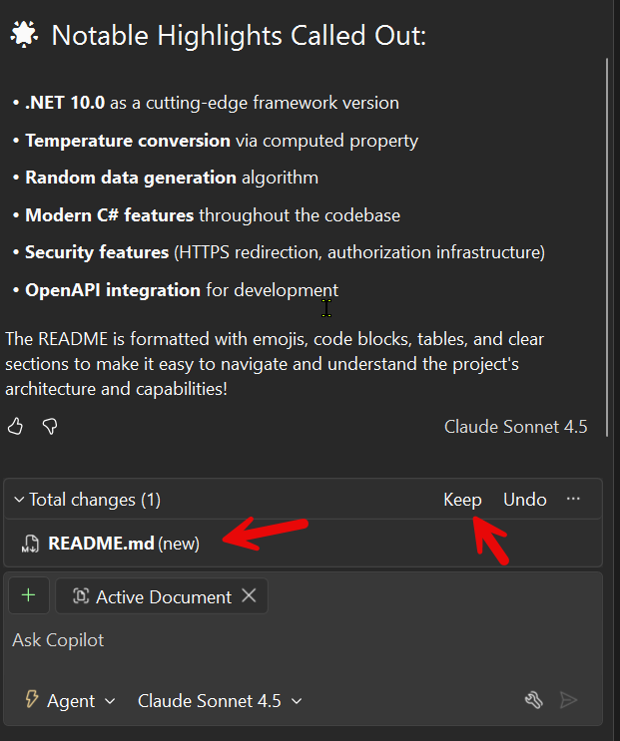
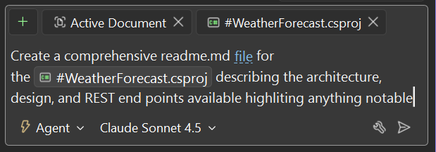
Weather Azure App Service AI Coding
GitHub Copilot can also create the readme.md file

Slide 40
ASP.NET Core API Template Example
WeatherForecastSolution.sln
WeatherForecast.csproj

Slide 41
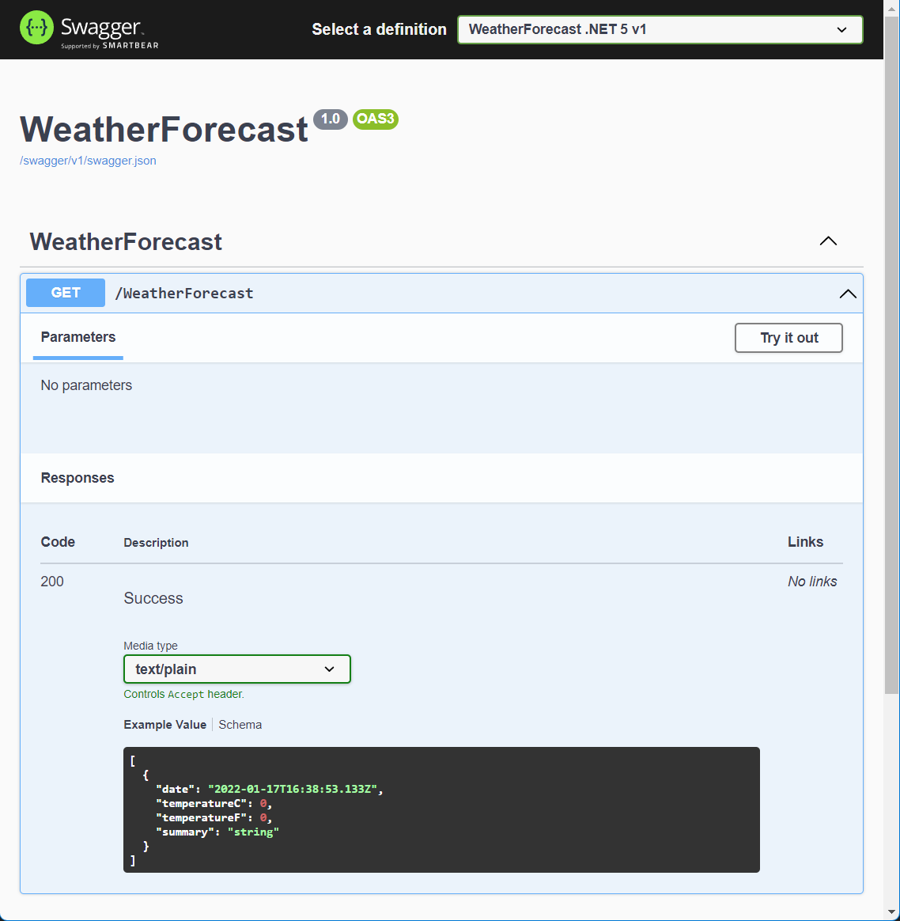
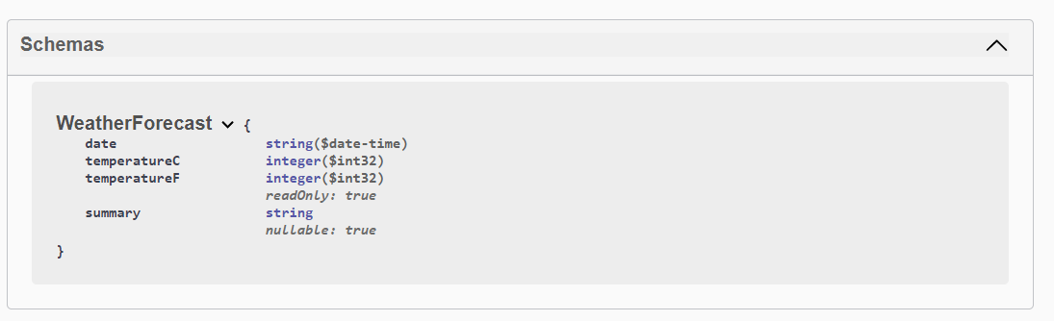
Adding REST Documentation
Web API supports documentation
UI Needs to be added
Via Swashbuckle nuget package Swashbuckle.AspNetCore (10.x)

Slide 42
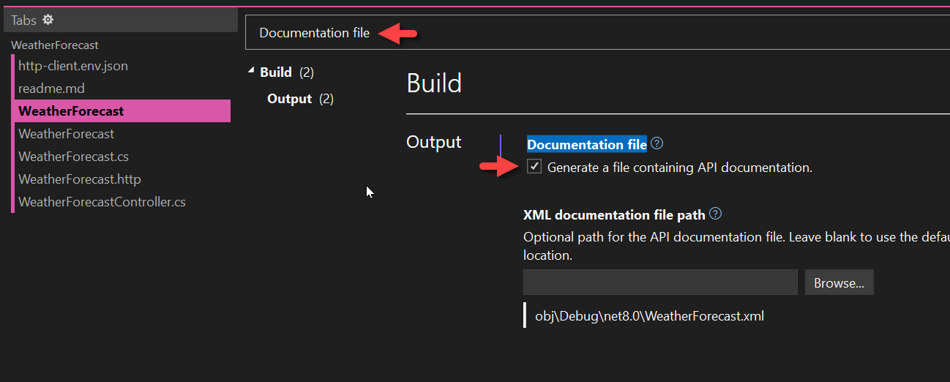
Adding REST Documentation
Suppress warnings
Right click on the project & choose properties
Search for documentation file

Slide 43
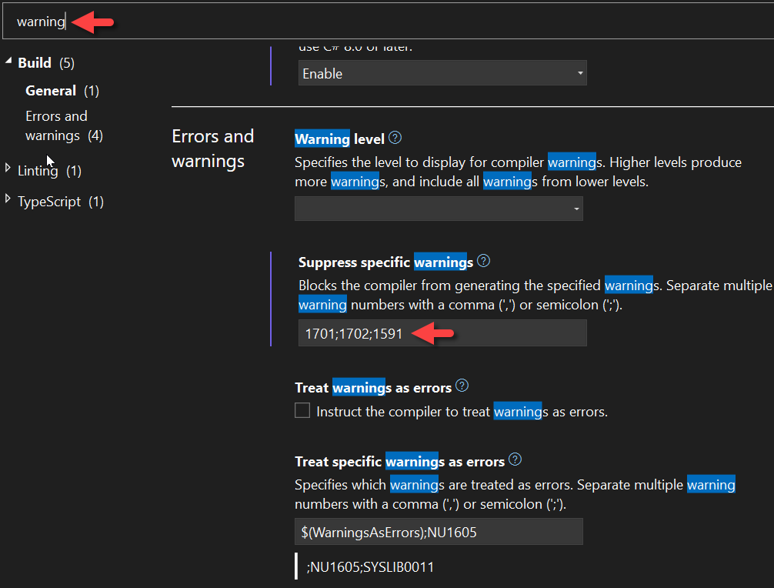
Adding REST Documentation
Suppress warnings
Right click on the project and choose properties
Search for warning, add 1591 to suppress comment warnings

Slide 44
Adding REST Documentation
Swagger Initialization code
var builder = WebApplication.CreateBuilder(args);
// Add services to the container.
builder.Services.AddControllers();
// Add Swashbuckle Swagger generation
builder.Services.AddSwaggerGen(c =>
{
// Add nice title
c.SwaggerDoc("v1", new OpenApiInfo { Title = "WeatherForecast Testing", Version = "v1" });
// Add documentation via C# XML Comments
var xmlFile = $"{Assembly.GetExecutingAssembly().GetName().Name}.xml";
var xmlPath = Path.Combine(AppContext.BaseDirectory, xmlFile);
c.IncludeXmlComments(xmlPath);
});

Slide 45
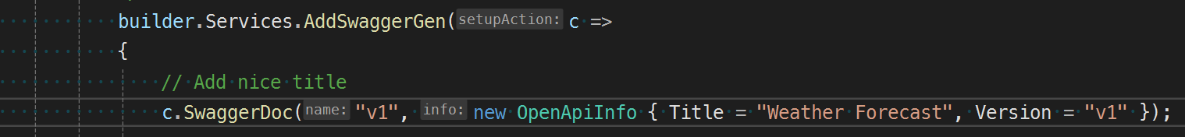

Adding REST Documentation
Title and Version Example

Slide 46

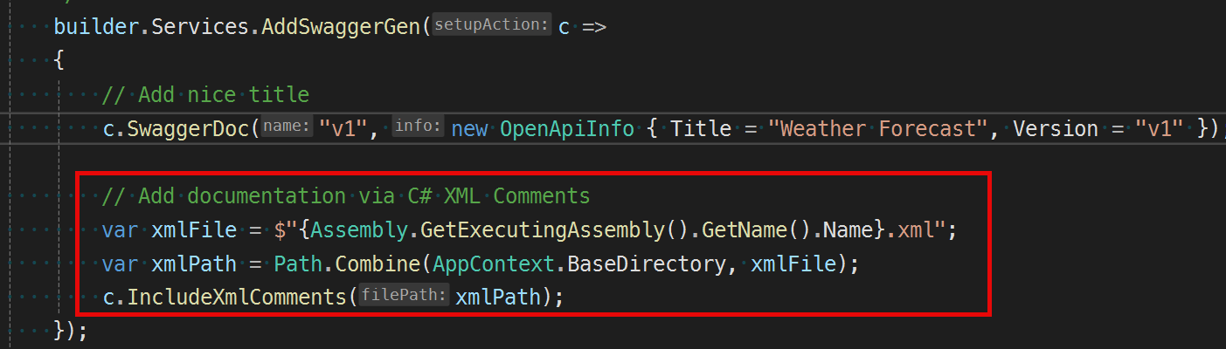
Adding REST Documentation
Don’t forget add the code to include the xml file
Why?
To see the C# XML API Comments, you added

Slide 47
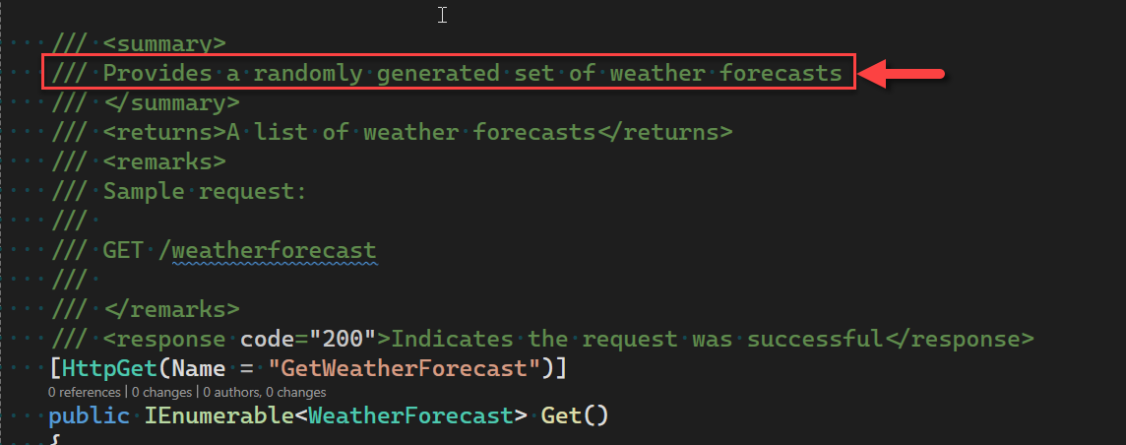
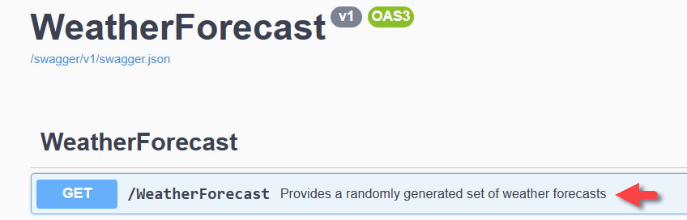
Adding REST Documentation
XML Comments Example

Slide 48
Adding REST Documentation
Swagger Initialization code
…
// Code Note: Moved outside of env.IsDevelopment() so both
// Debug and Release are supported
app.UseSwagger();
// Customize the UseSwaggerUI()
app.UseSwaggerUI(c =>
{
// 1. Display a friendly title
c.SwaggerEndpoint("/swagger/v1/swagger.json", "v1");
// Code Note:
// Launch the Swagger UI by default
// Serving the Swagger UI at the app's root
// (http://localhost:<port>)
c.RoutePrefix = string.Empty;
});
…

Slide 49

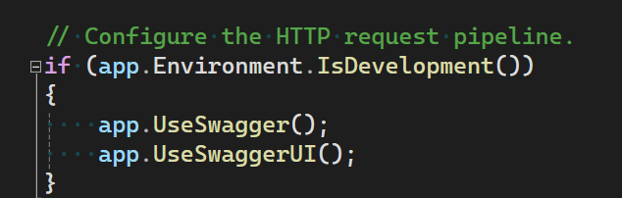
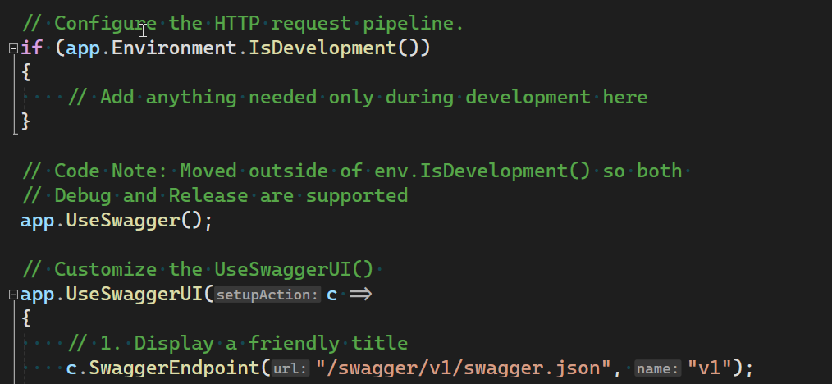
Adding REST Documentation
Don’t forget to move out of IsDevelopment()
Why?
Won’t see swagger UI when deployed to Azure

Slide 50
Adding REST Documentation
Extending WeatherForecast API App with Swagger Doc WeatherForecastSolution.sln WeatherForecast.csproj

Slide 51
Agenda
Essential REST Verbs
GET
Retrieve a single item by Id
Retrieve a list of items when no Id is provided
POST
Create resource, server generates Id
PUT
Update a resource by replace its content
Create a resource using Id provided by caller

Slide 52
Agenda
Essential REST Verbs
PATCH
Update a resource by replace parts of its content
DELETE
Delete a resource

Slide 53
Essential REST
GET, POST, PUT, PATCH, DELETE WeatherForecastTestingSolution.sln WeatherTestingForecast.csproj

Slide 54
Questions

Slide 55
Best Practices
Be stateless
Be asynchronous
Execute I/O operations on non request thread
Measure then optimize
Cache as close to the wire as possible
Think carefully about your caching policy
Servers shall be expendable
They will fail, plan for it in your design

Slide 56
Further Reading
Azure for Developers: 3rd Edition
Author: Kamil Mrzygłód
ISBN: 978-1836203513
Chapter 1

Slide 57
Further Reading
Optional Book: C# 14 and .NET 10 – Modern Cross-Platform Development Fundamentals
Chapter 15 Building and Consuming Web Services
Author: Mark J. Price
ISBN: 978-1836206637

Slide 58
Further Reading
Building Cloud Apps with Microsoft Azure
Authors: Scott Guthrie, Mark Simms, Tom Dkystra, Rick Anderson, Mike Wasson
ASIN: B00LXAAMSG
Chapters: 4, 9, 11

Slide 59
Links
Azure App Services (API and Web)
App Service documentation
ASP.NET Core
ASP.NET documentation
Create a web API with ASP.NET Core and Visual Studio for Windows
Tutorial: Create a web API with ASP.NET Core
Generate OpenAPI documents | Microsoft Learn

Slide 60
Links
Publish an ASP.NET Core app to Azure with Visual Studio
Publish an ASP.NET Core app to Azure with Visual Studio Code
Publish an ASP.NET Core web app with CLI tools

Slide 61
Links
Visual Studio 2026
Built in support for .http files
Visual Studio Code Extensions
Azure App Service
Azure Developer CLI
Azure Resources
Azure Tools
Bicep
C#
C# Dev Kit
REST Client

Slide 62
REST Utilities
Postman
Make REST calls from a richly featured UI
https://www.getpostman.com/
Nightengale
https://nightingale.rest/
cURL
Included in Windows 11
Rest calls from the command line

Slide 63
REST Utilities
Fiddler
Make REST Calls
Examine / Debug request/response
http://www.telerik.com/fiddler
Firefox extension:
RESTClient

